Slide 1



FINAL EXAM
8 Dec 2024
Phuc-Loi Luu, PhD
Luu.p.loi@googlemail.com
THE 3rd VIETNAM SCHOOL OF BIOLOGY (VSOB-3)
Bioinformatic Analysis For Bulk RNAseq Data
December 06th-08th, 2024, ICISE, Quy Nhon, Vietnam

Slide 2
Part 1: Fill in the blanks

Slide 3
Matching column A and B
1.1
Answer | No. A | A | No. B | B
 | A | <3% of the genome is subsequently translated into proteins genes which are? | 1 | Poly A tails
 | B | Non-coding RNAs cover a wide range of functions including protein assembly and ? | 2 | rRNA
 | C | miRNAs | 3 | Coding or non-coding genes
 | D | Pathway enrichment analysis, gene ontology analysis and functional analysis | 4 | Affymetrix
 | E | Gene Expression microarray | 5 | FastQC and Trimmomatic
 | F | BWA, Bowtie and Stampy | 6 | 18-23bp
 | G | mRNAs | 7 | Measure gene expression
 | H | Reference-independent | 8 | Unspliced aligner
 | I | featureCounts | 9 | g:Profile, GSEA and DAVID
 | J | qRT/PCR, Northern blotting, FISH, microarray, RNA-seq | 10 | Gene-level quantification
 | K | Preprocessing | 11 | gene expression regulation
 | L | 90-95% | 12 | Trinity, Oases and transABySS
 | M | Spliced aligner | 13 | STAR and TopHat

Slide 4
Answer
Answer | No. A | A | No. B | B
3 | A | <3% of the genome is subsequently translated into proteins genes which are? | 1 | Poly A tails
11 | B | Non-coding RNAs cover a wide range of functions including protein assembly and ? | 2 | rRNA
6 | C | miRNAs | 3 | Coding or non-coding genes
9 | D | Pathway enrichment analysis, gene ontology analysis and functional analysis | 4 | Affymetrix
4 | E | Gene Expression microarray | 5 | FastQC and Trimmomatic
8 | F | BWA, Bowtie and Stampy | 6 | 18-23bp
1 | G | mRNAs | 7 | Measure gene expression
12 | H | Reference-independent | 8 | Unspliced aligner
10 | I | featureCounts | 9 | g:Profile, GSEA and DAVID
7 | J | qRT/PCR, Northern blotting, FISH, microarray, RNA-seq | 10 | Gene-level quantification
5 | K | Preprocessing | 11 | gene expression regulation
2 | L | 90-95% | 12 | Trinity, Oases and transABySS
13 | M | Spliced aligner | 13 | STAR and TopHat

Slide 5
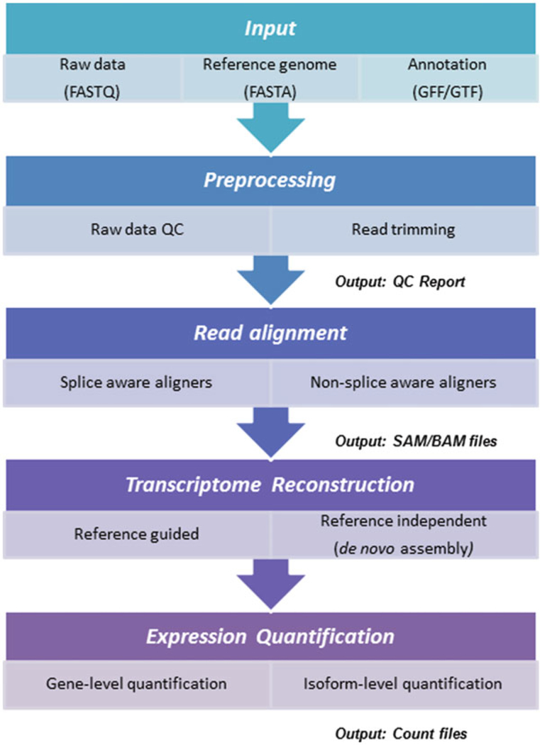
Fill in the blanks
1.2
1
2
Please fill in the blanks with the numbers
3
4
5
6
7
8

Slide 6
1.2

Slide 7
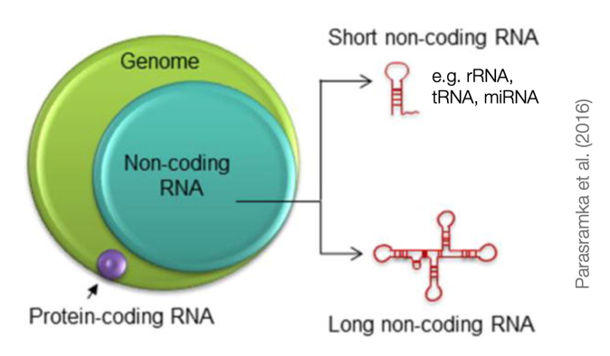
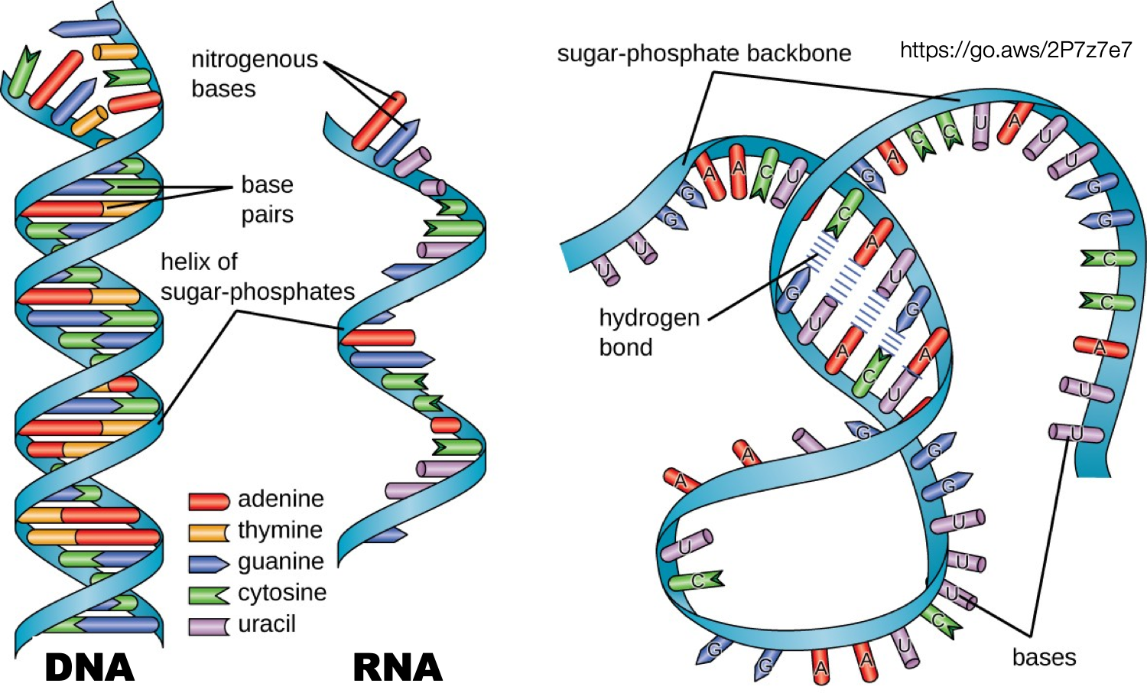
Fill in the blanks
1.3
7
1
2
8
5
6
3
4

Slide 8
tRNA
rRNA/non-coding RNA
Protein-coding RNA
Long non-coding RNA
DNA
RNA
? Unstranded RNA/ Photphat bond
Hydro bond/ stranded
1.3

Slide 9
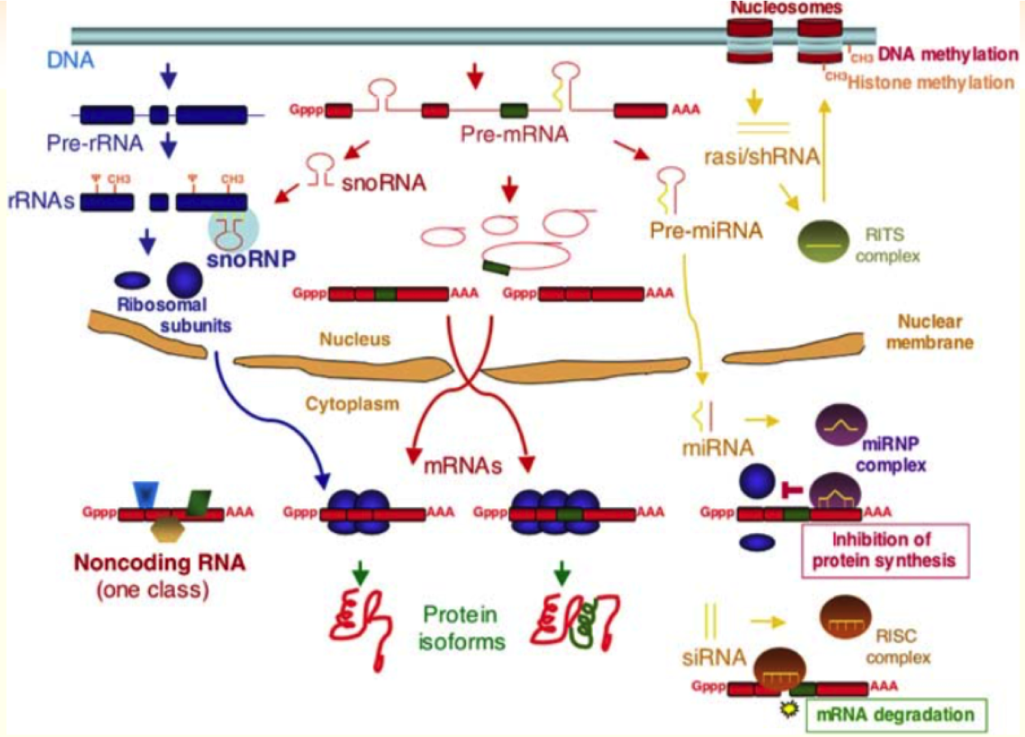
Fill in the blanks
1.4
1
2
3
5
4

Slide 10
1.4
Pre-mRNA
rRNA
Cytoplasm
Protein
miRNA

Slide 11
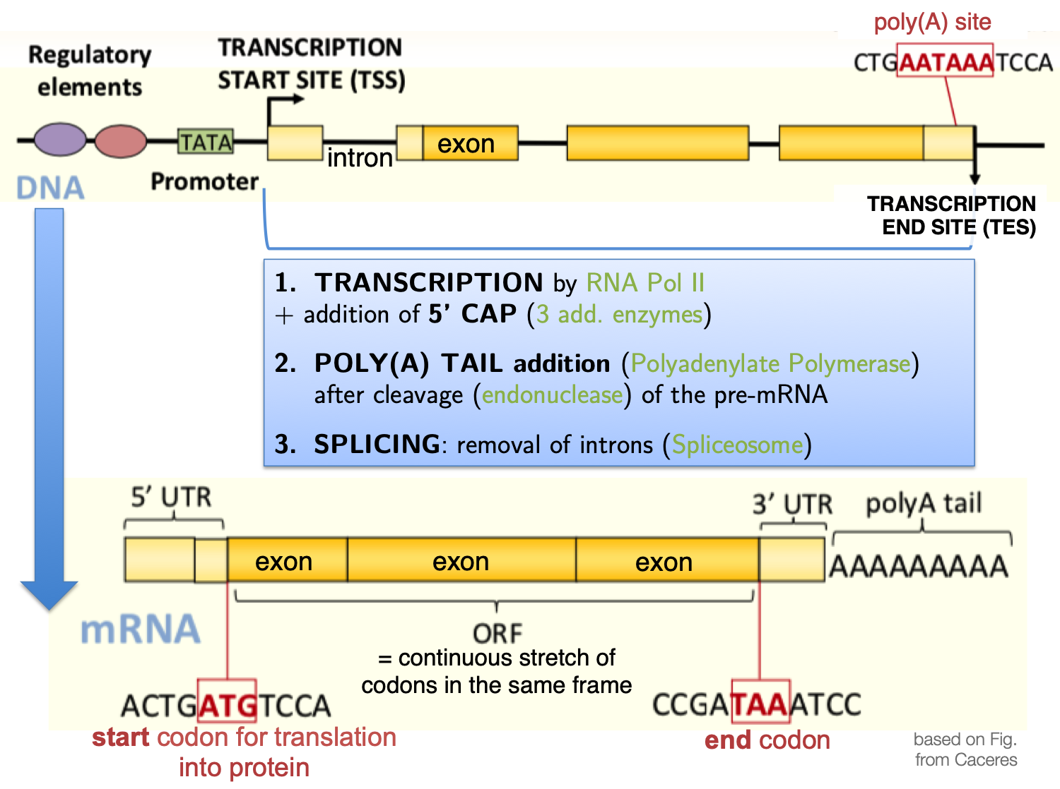
Fill in the blanks
1.5
4
2
3
1
5

Slide 12
1.5
Promoter
TSS
Intron
PolyA
PolyA

Slide 13
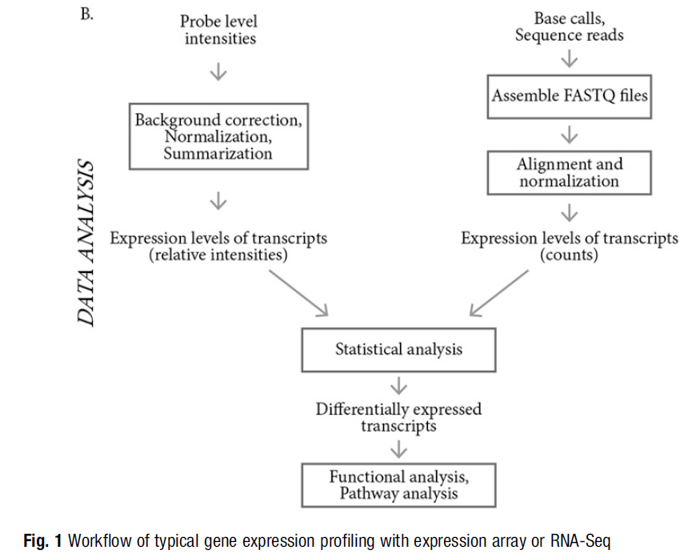
Fill in the blanks
1.6
1
2
3
3
4
5
10.1007/978-1-4939-7834-2_2
1
2

Slide 14
1.6
Microarray
RNA-seq
QC and Normalization
DGEs
Pathways

Slide 15
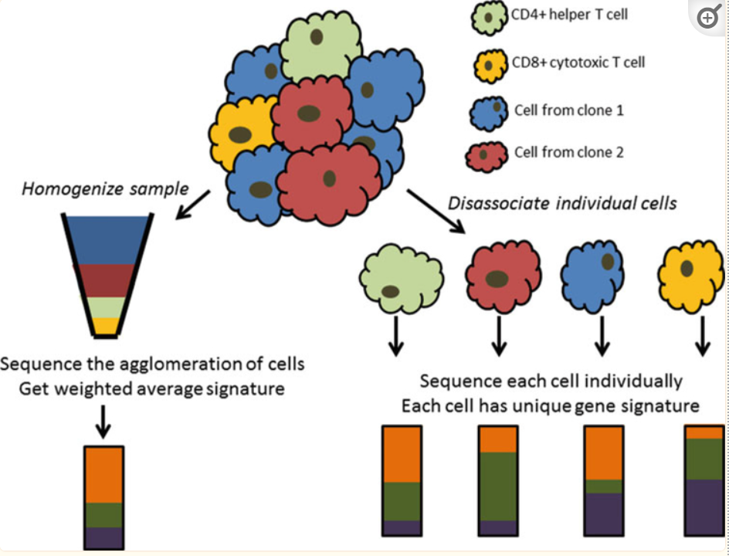
Fill in the blanks
1.7
1
2
3

Slide 16
1.7
Dissociate
Average
Single cell

Slide 17
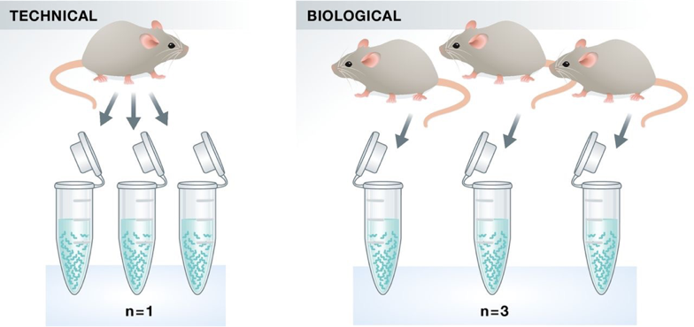
Fill in the blanks
1.8
1
2
3
4

Slide 18
1.8
Technical Replicates
Biological Replicates
N=1
N=3

Slide 19
Part 2: Explain Question

Slide 20
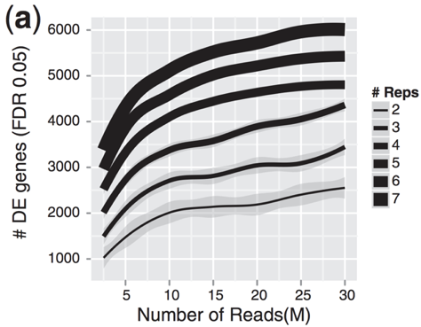
2.1
Explain Question
Provide an explanation of your understanding about this

Slide 21
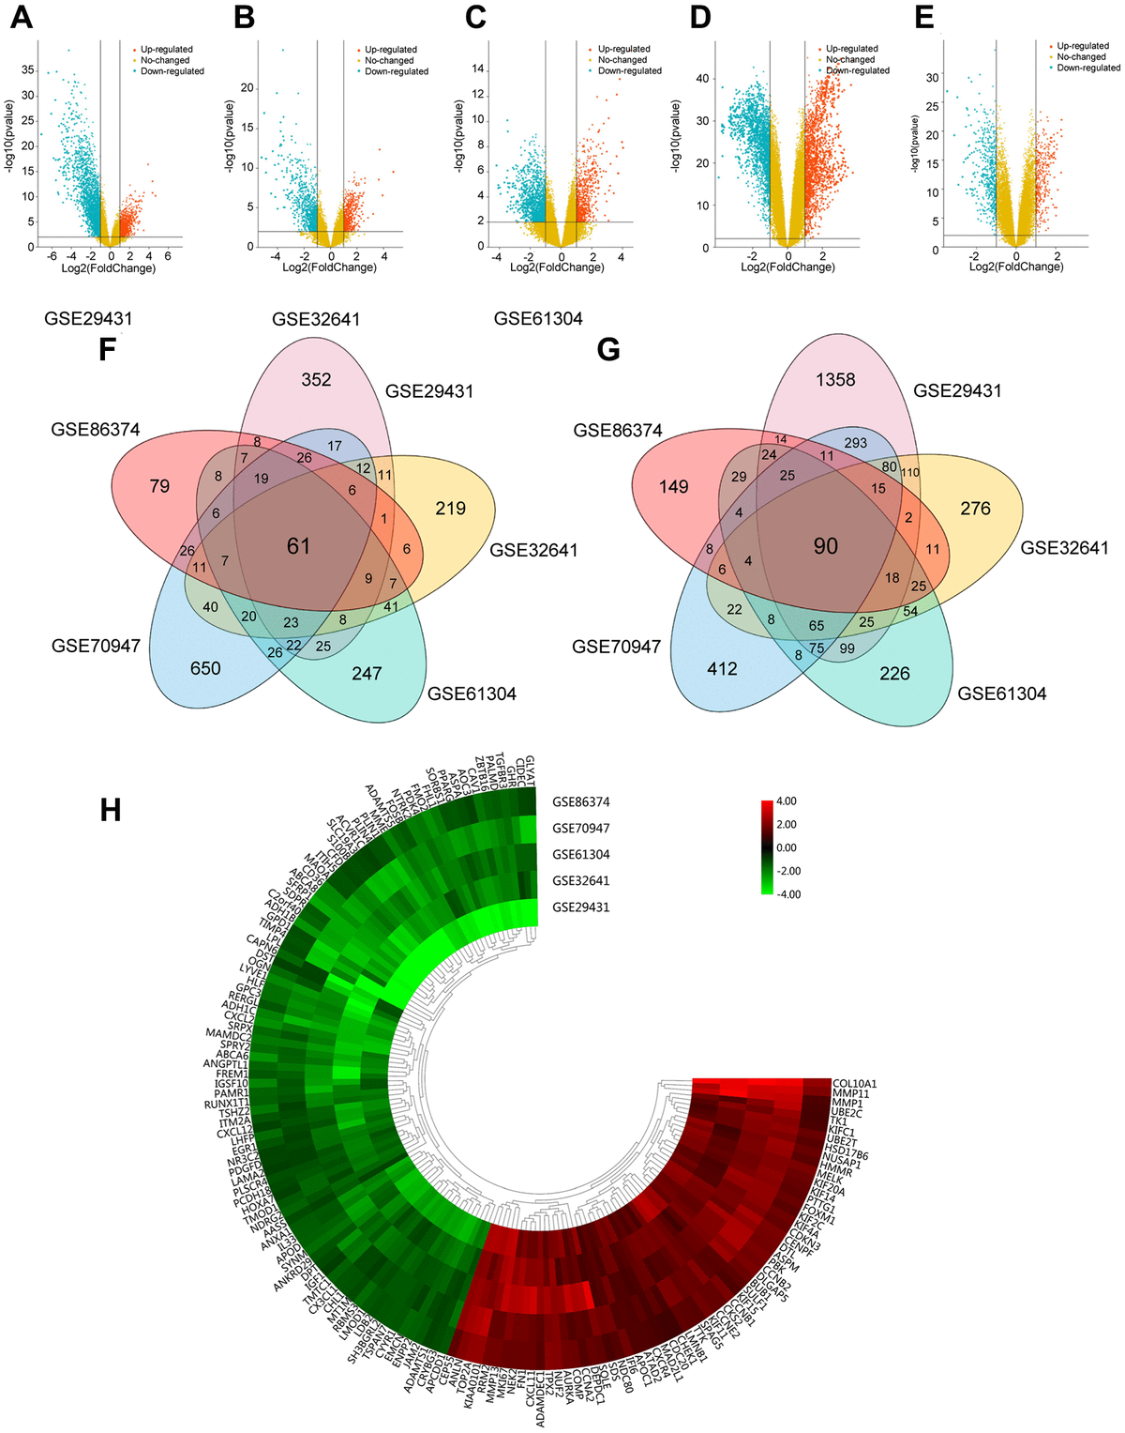
2.2
Explain Question
Provide an explanation of your understanding about this
https://www.aging-us.com/figure/203178/f1
Figure 1. Foundation of DEGs in five GEO databases. (A–E) The display of DEGs in each database by volcano plots. Datasets from GSE29431 (A), GSE32641 (B), GSE61304 (C), GSE70947 (D) and GSE86374 (E). Orange: Up-regulated genes (logFC ≥ 1.0, adj. P < 0.05); Blue: Down-regulated genes (logFC ≤ -1.0, adj. P < 0.05); Yellow: Genes with no significance. (F–G) A Total of 61 significantly upregulated genes (F) and 90 significantly downregulated genes (G) were screened from the five GEO databases. (H) Hierarchical clustering heatmap showed expression of 151 DEGs in five GEO databases. Red: higher expression genes, green: lower expression genes.

Slide 22
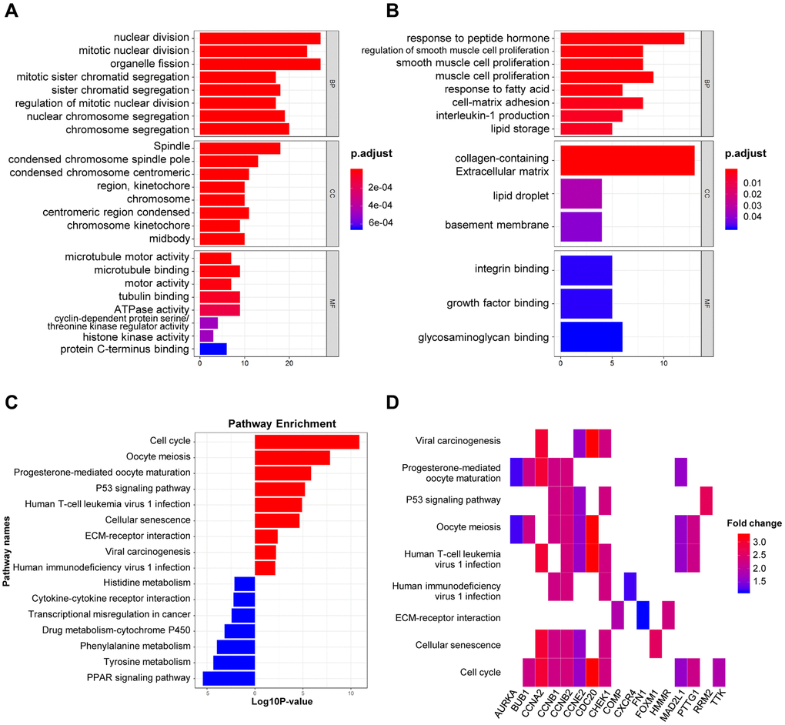
2.3
Explain Question
Provide an explanation of your understanding about this
https://www.aging-us.com/article/203178/text
Figure 2. GO and KEGG analysis of DEGs in BRCA. (A–B) The biological processes, cellular components, and molecular functions of 61 up-regulated DEGs (A) and 90 down-regulated DEGs (B) were displayed by GO analysis. (C) The signaling pathways of 151 DEGs were displayed by KEGG analysis. (D) Heatmap of the significant enrichment results in the KEGG pathway.

Slide 23
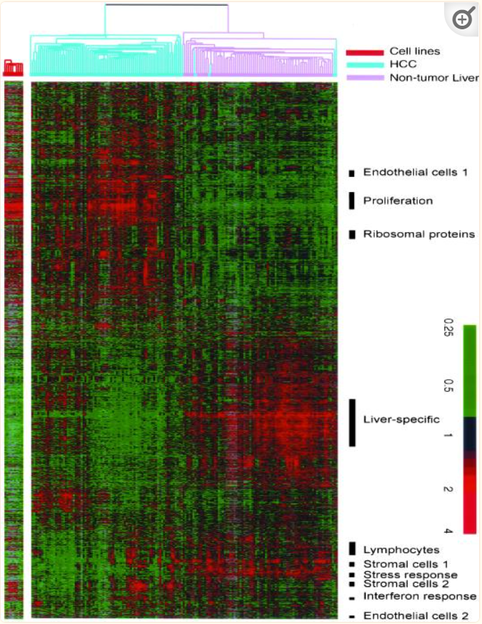
2.4
Explain Question
Provide an explanation of your understanding about this
https://www.ncbi.nlm.nih.gov/pmc/articles/PMC117615/
Figure 1 Hierarchical clustering of the patterns of variation in expression of 3180 genes (represented by 3964 cDNA), in 156 liver tissues (74 nontumor liver and 82 HCC). The data are shown in a table format, in which rows represent individual genes and columns represent individual tissue or cell sample. The color in each cell reflects the expression level of the corresponding gene in the corresponding tissue, relative to its mean expression level across the entire set of tissue samples. The scale extends from fluorescence ratios of 0.25–4 relative to the mean level for all samples. Gray indicates missing or excluded data. Expression of the same genes in 10 HCC cell lines is similarly represented in the panel to the left of the main panel. See supplementary information for the full data, including sample names.

Slide 24
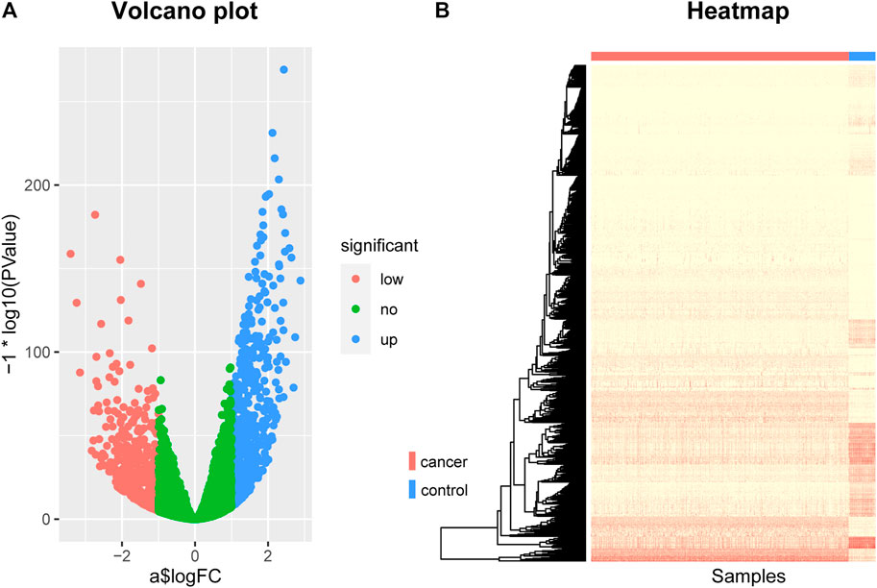
2.5
Explain Question
https://www.frontiersin.org/articles/10.3389/fcell.2021.811585/full
FIGURE 1. The Volcano plot and Heat map of differentially expressed genes. (A) The Volcano plot of differentially expressed genes, where the red dots represent the genes that are down-regulated in breast cancer, the blue dots represent the genes that are up-regulated in breast cancer, and the green dots represent the genes that are not significantly different. (B) The Heat map of differentially expressed genes. The rows represent differentially expressed genes and the columns represent patients, where the red bar represents breast cancer patients and the blue bar represents normal control samples.

Slide 25
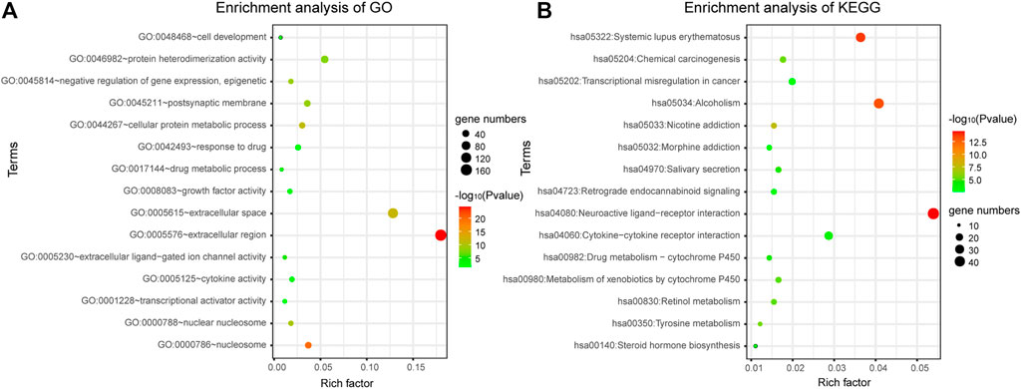
2.6
Explain Question
Provide an explanation of your understanding about this
https://www.frontiersin.org/articles/10.3389/fcell.2021.811585/full
FIGURE 2. Gene enrichment analysis. (A) Gene enrichment analysis of Gene Ontology. (B) Gene enrichment analysis of KEGG.

Slide 26
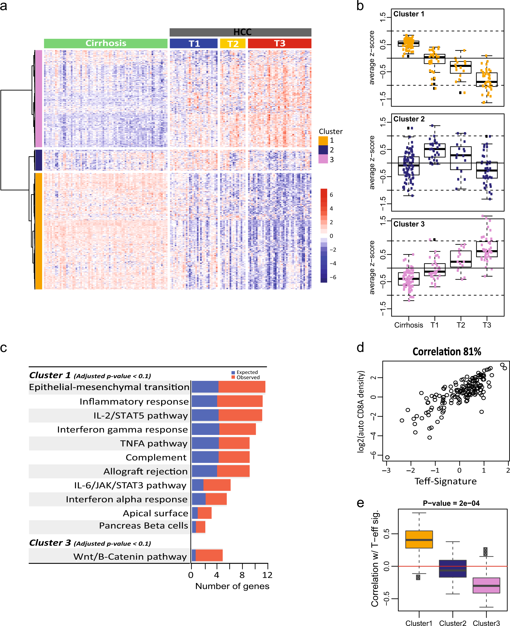
2.7
Explain Question
https://www.nature.com/articles/s41698-018-0068-8/figures/1

Slide 27
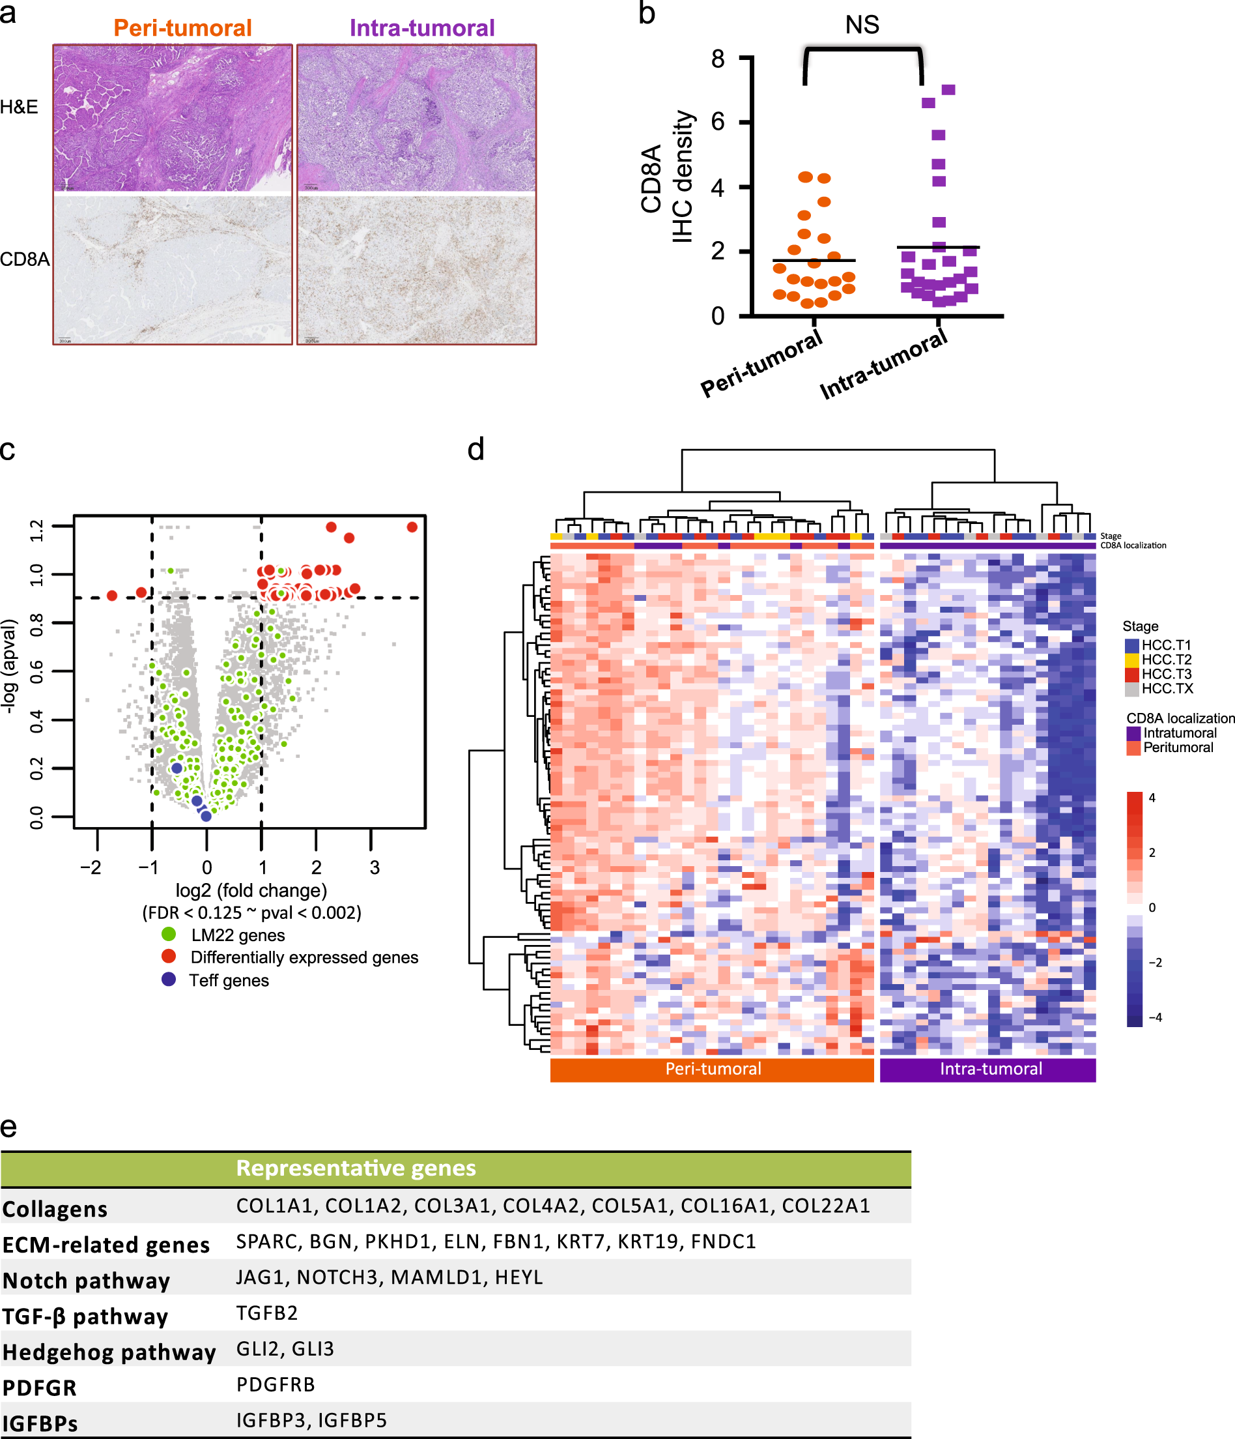
2.8
Explain Question
https://www.nature.com/articles/s41698-018-0068-8/figures/2

